Slide 1
Rationalising Surds
Mini lesson 3

Slide 2
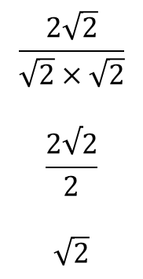
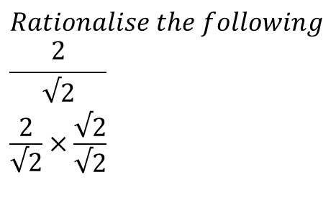
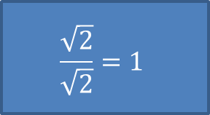
Surds
EQ: How do we rationalise surds
Rationalising surds is getting rid of the surd in the denominator of a fraction
$$Rationalise the following \\ \frac{2}{\begin{aligned}√2 \\ \frac{2}{\begin{aligned}√2 \\ \end{aligned}}×\frac{√2}{√2}\end{aligned}}$$
$$\frac{\sqrt{2}}{\sqrt{2}}=1$$
Anything multiplied by 1 stays the same value.
$$\frac{2\sqrt{2}}{\sqrt{2}×\sqrt{2}}$$
$$\frac{2√2}{2}$$
$$\sqrt{2}$$

Slide 3

Example
$\frac{4}{2\sqrt{3}}$ $$=\frac{4}{2\sqrt{3}}×\frac{\sqrt{3}}{\sqrt{3}}$$
$$=\frac{4\sqrt{3}}{2×3}$$
$$=\frac{4\sqrt{3}}{6}$$
$$=\frac{2\sqrt{3}}{3}$$

Slide 4
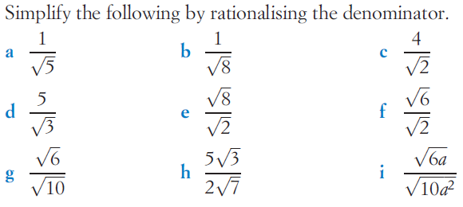
Rationalise these please

